Slide 1

Sailing THROUGH the STORM
how Nestlé Vietnam is overcoming COVid-19 challenges
Binu Jacob, CEO of Nestlé Vietnam
Hanoi, 25th September 2020

Slide 2




NESTLÉ IN VIETNAM
1992 1995
~CHF700 Mio
Invested
~2800
Employees
369 Nestles Distribution Partners
~10.000 Indirect employment
> 50% Female managers
No. 1 Coffee Buyer in Vietnam
21,000 farmer households 4C verified
230,000 Training sessions for farmers
4 + 2 Factories

Slide 3
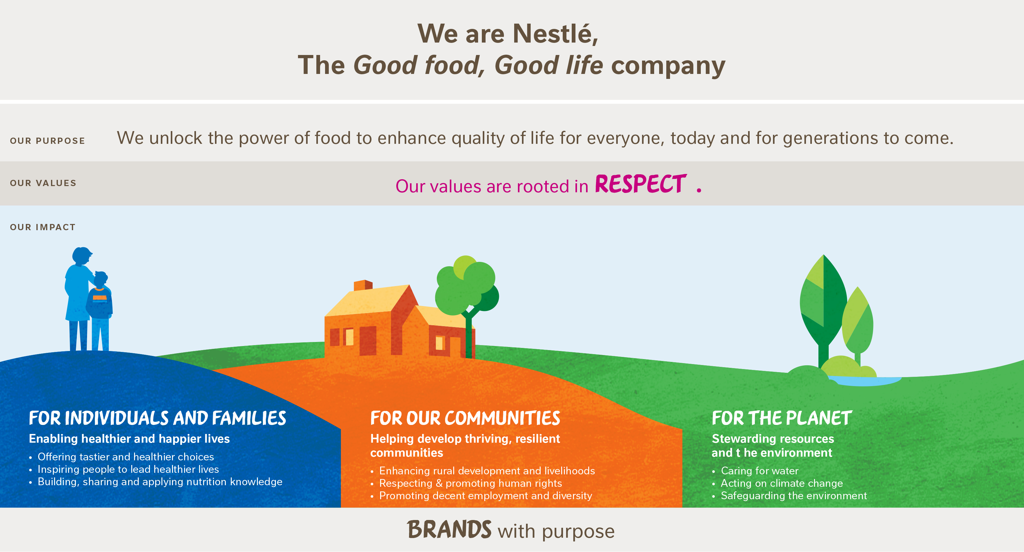

Slide 4
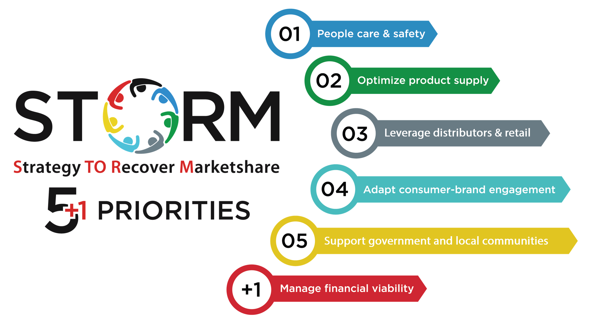
As soon as COVID hit, we set up a PROJECT STORM taskforce

Slide 5
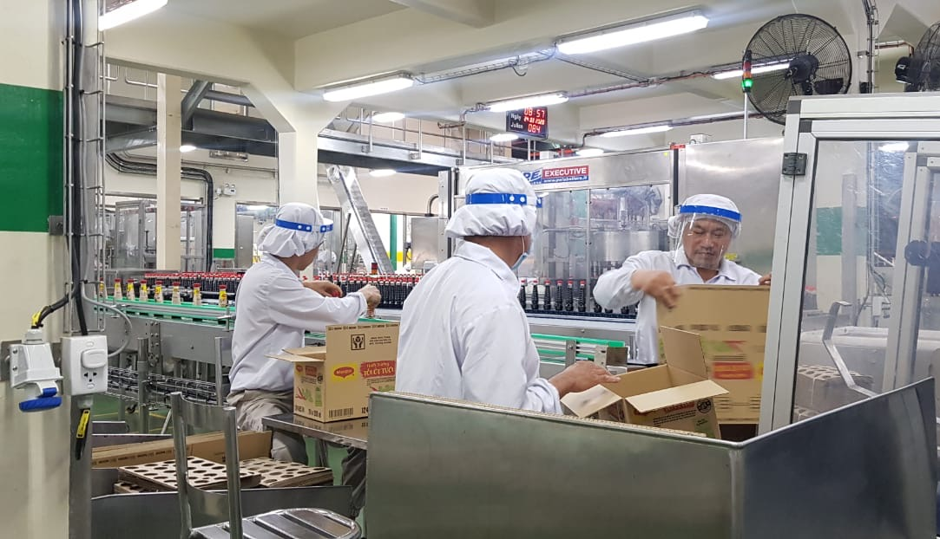
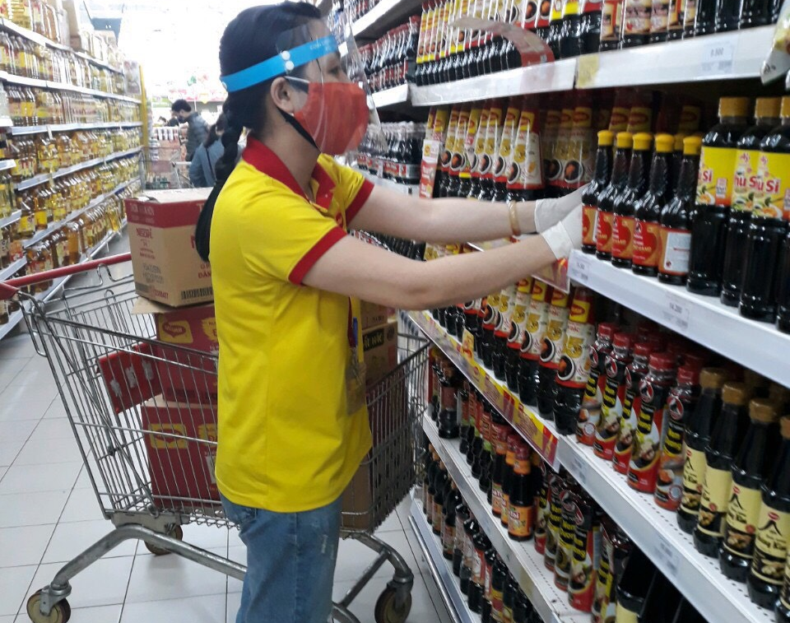
STREAM 1: PEOPLE CARE & SAFETY
COVID-19 Prevention Committee established with daily meetings.
Applied additional safety measures in all sites.
Provided 58,000 PPE items (face masks, face shields, goggles)
Rewarded employees who work to ensure the continuity of product supplies to the communities in need.
Weekly livestream to the entire organization to let them know
Not a single person laid off & salary was increased not decreased

Slide 6
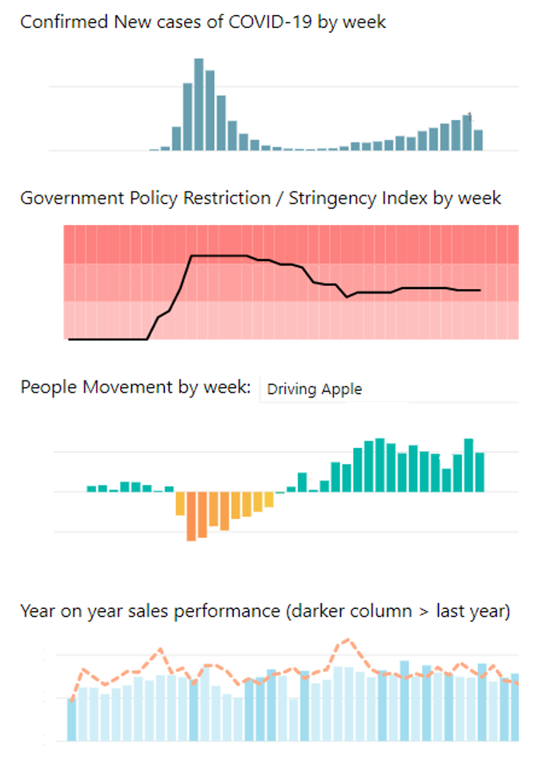
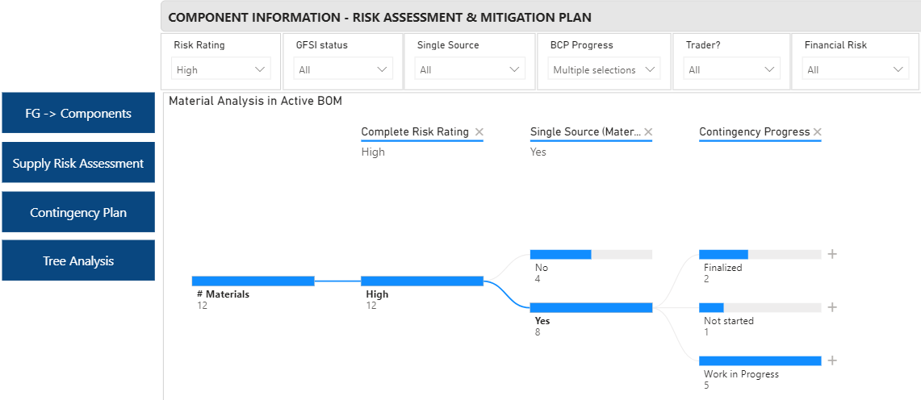

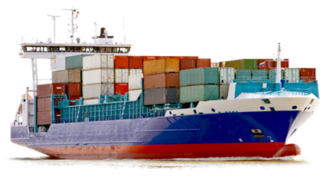
STREAM 2: OPTIMIZE PRODUCT SUPPLY
Business Continuity Plan – training / executing internally; responding quickly to changing circumstances and working with Suppliers to ensure supply.
Full Supply Risk Assessment & prioritization on mitigation plans
Demand Response - adjusting production & managing stock cover / product freshness at all sites, through our distributors and into retail.
Export Sales Growth - >20%. Supporting Nestlé businesses worldwide.
Notes:
1) Business Continuity Plan for scenarios:
Mandatory controls: 2m rules, mask wearing, sanity & cleaning process
New practices in operations for “New normal”
Ready-to-Deploy solutions in case of infection
2) Supply Risk Assessment
Supplier Financial Assessment
Origin Risk (Supplier Tier 1, Tier 2, Traders)
Single Source Risk
Supply Risk criteria (planning, supply market, nestle inherent, …)
Mitigation Strategies:
Industrial services contingency at Factories
Cross docking at Transporters to optimize logistics
Labor profiles & health-check risk impacts on External Workforce
Communicate rolling forecast with suppliers, issue purchase order for 3 months requirements with oversea suppliers, 3 weeks for packaging materials under top 20 SKUs
BCP at supplier sites (i.e. Tetra Pak BCP)
Identify all sea/air shipments until Q3 2020 of key projects
Review GAPs of buying and opportunities (i.e. Dairy, Sugar …)
4) Export Opportunities:
Products: Coffee Powder, Milo Powder, Maggi Liquid
Markets: EU, US, Philippine, Australia

Slide 7
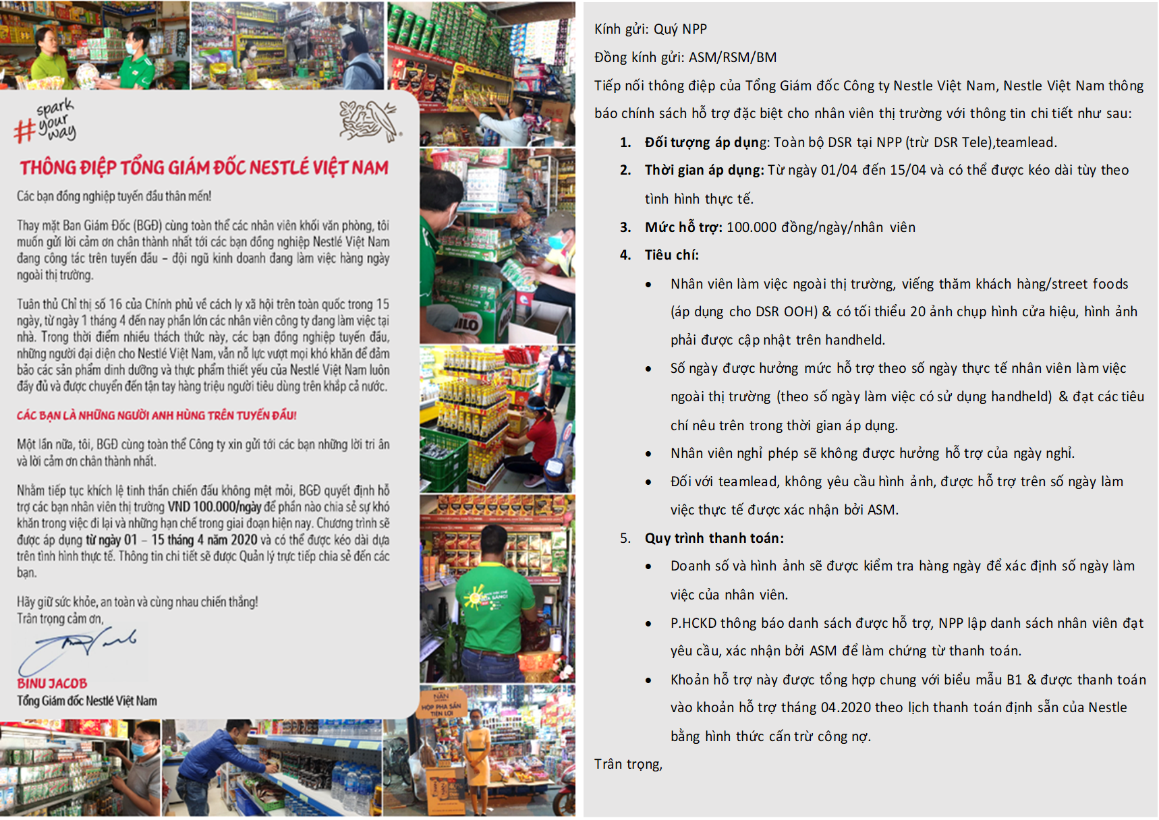
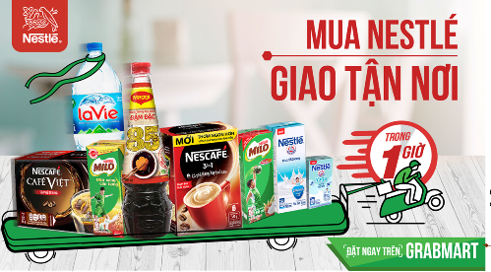

STREAM 3: LEVERAGE DISTRIBUTORS & RETAILS
Ensure smooth operations of Distributors/Retailers
  Ensure enough stocks to supply to Distributors and Retailers (no out of stock).
  Partner with Key Account & E-Commerce Customers to directly deliver to shoppers.
Special Support
  Support Distributors and Salesmen with special incentive schemes (Field Disruptive Allowance, masks, hygiene liquid).
  Exchange fresh stock for Out-of-home partners impacted by COVID-19.
  Support small vendors to recover business after the pandemic.

Slide 8
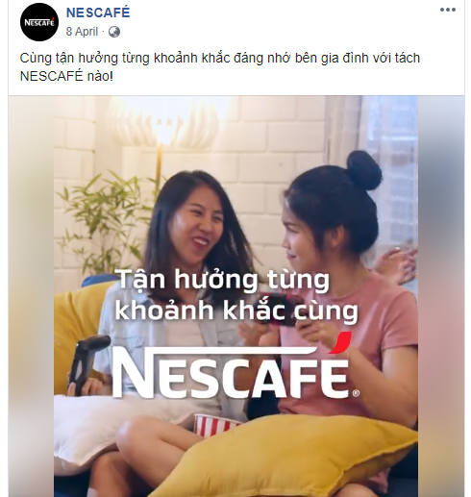

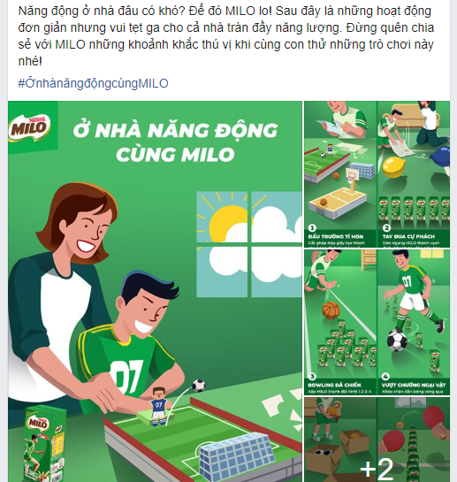
STREAM 4: ADAPT CONSUMER-BRAND ENGAGEMENT
Brand campaigns implemented to connect with and to lift up the spirit of thousands of consumers:
“Nestlé MILO - Ở nhà nhưng đừng ở yên” (“Stay home but don’t stay idle”).
“MAGGI - Cơm nhà ngon khỏe” (“Healthy and tasty meals at home”).
“NESCAFÉ - Trở thành Barista tại gia” (“Becoming a Barista at home”).

Slide 9
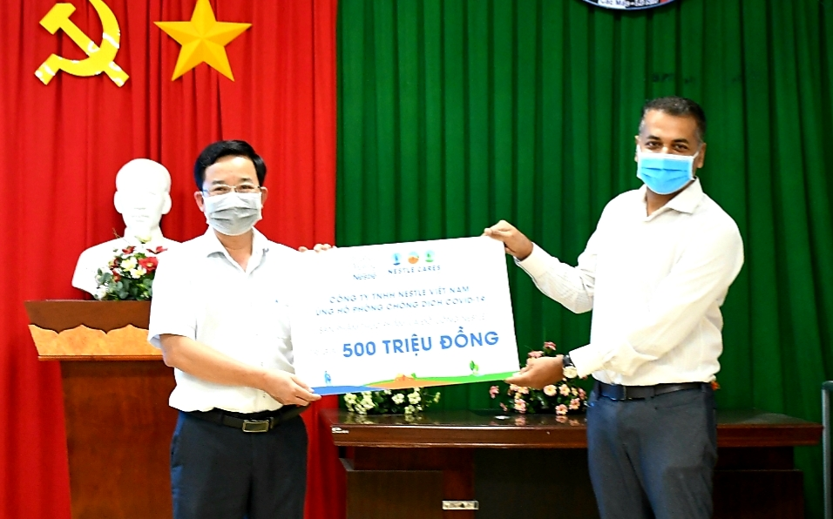
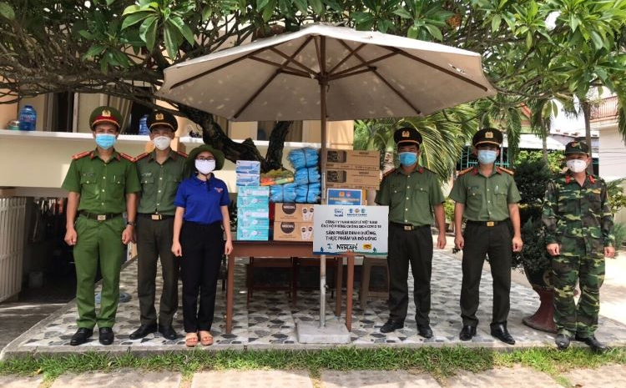
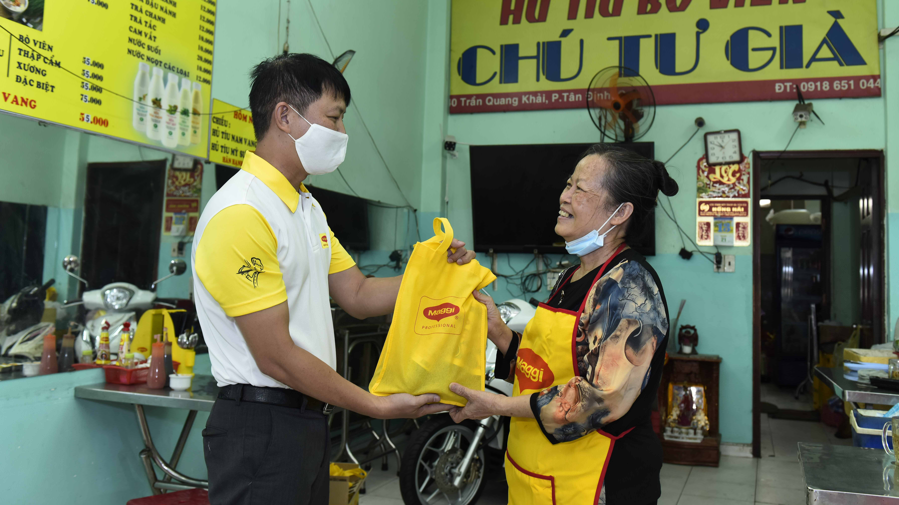
STREAM 5: SUPPORT GOVERNMENT & LOCAL COMMUNITIES
Donated over VND36.8 billion in products and cash to the frontline workers and people affected with the pandemic in 20 cities and provinces.
Provided 88,000 medical masks to the Ministry of Health and 5 Provincial CDCs.
Support given to 22,000 small Out-of-Home customers (OOH) nationwide including small restaurants, street vendors, school canteens, who are impacted by COVID-19.

Slide 10
KEY TAKEAWAYS
Bring structure, clarity and calmness to the chaos & confusion
People first. Everything else second.
Communicate. Communicate. Communicate.
Act fast. Done is better than perfect.
A crisis is a time to give. Not take.

Slide 11

Thank you!

